Slide 1
Additional Comments on Cohorts
Research Considerations
CPH573A

Slide 2
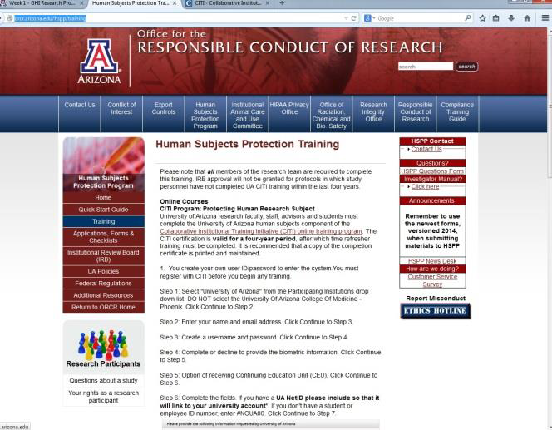
You may or may not yet have completed your CITI Training – Responsible Conduct of Research – prior to taking this course.

Slide 3

However, the Ethics of administering any type of research (assessment / evaluation) should always be in the back of your mind.
ethics
Chapter 17 (week 1)
Foundational to all Public Health disciplines

Slide 4

Research – even if you call it “evaluation”, “assessment”, or “examination” is the systematic study of ….(whatever).
I wonder if these are related by X.
In other words, there is thought and purpose behind it, before it begins.

Slide 5

Research / Studies are NOT
Fishing expeditions

Slide 6
Three fundamental principles guide the ethical conduct of research involving human subjects. These principles come from The Belmont Report.
The Belmont Report is a statement of basic ethical principles and guidelines that assist in resolving the ethical problems that surround the conduct of research with human subjects.

Slide 7
Respect for Persons (autonomy)
Individuals should be treated as autonomous agents, capable of deliberating and making decisions on their own.
Beneficence
Researchers are obligated to minimize possible harm and maximize possible benefits.
Justice
Research participants should be treated fairly and risks and benefits evenly distributed.

Slide 8
Potential projects are reviewed by Institutional Review Boards (IRB) to ensure that along with being well-designed, the risks to the participants in the study are justified by the potential benefits of the findings.
In other words, a researcher can’t choose to examine something just for “kicks”. There needs to be an anticipated benefit for participants or society.

Slide 9



“Loss of confidentiality” - having personal information strewn about – can be quite detrimental for a participant.

Slide 10


The more information requested, the greater the risk,
- in additional to the greater time and effort involved from the participant to provide that information.

Slide 11
So what does all IRB concerns have to do with Cohort Studies?
IRB concerns
Cohort Studies are designed – and approved – based on stated hypotheses.
Investigators are not simply “collecting all the info they can acquire” and then “creating a scenario to examine the info collected”
Cohort Studies are started, administered, and ethically responsible to analyze data collected based on initial hypotheses stated.

Slide 12
Many of the well-known cohorts, that have provided important analyses & data, have been approved to continued beyond their initial hypotheses.
While continuing beyond initial aims can be advantageous for examining additional hypotheses (more bang for the buck), it is CRITICAL to assess whether the cohort actually had the appropriate data – or the best data – collected in an appropriate time-frame, to examine the exposures and outcomes on which the cohort may be reporting!

Slide 13
In brief, know your cohort!
When you are reading an article, that cohort X found such and such, you need to critically consider whether cohort X really had the right – or best – data to examine the hypotheses.

Slide 14
When ‘results’ get published using less than ideal data, it hurts everyone.
Results taken as “true” although not based on an appropriate study. Depending on source, may get a lot of press
Conclusion may not be valid & can take a long time to “disprove”
More difficult for another research group to get funding to look at similar hypothesis, even if designing a study that is using better data/measures.

Slide 15
In brief, know your cohort!
Why was the cohort created?
What was it designed to examine?
In other words, what does it have good data to examine well?

Slide 16
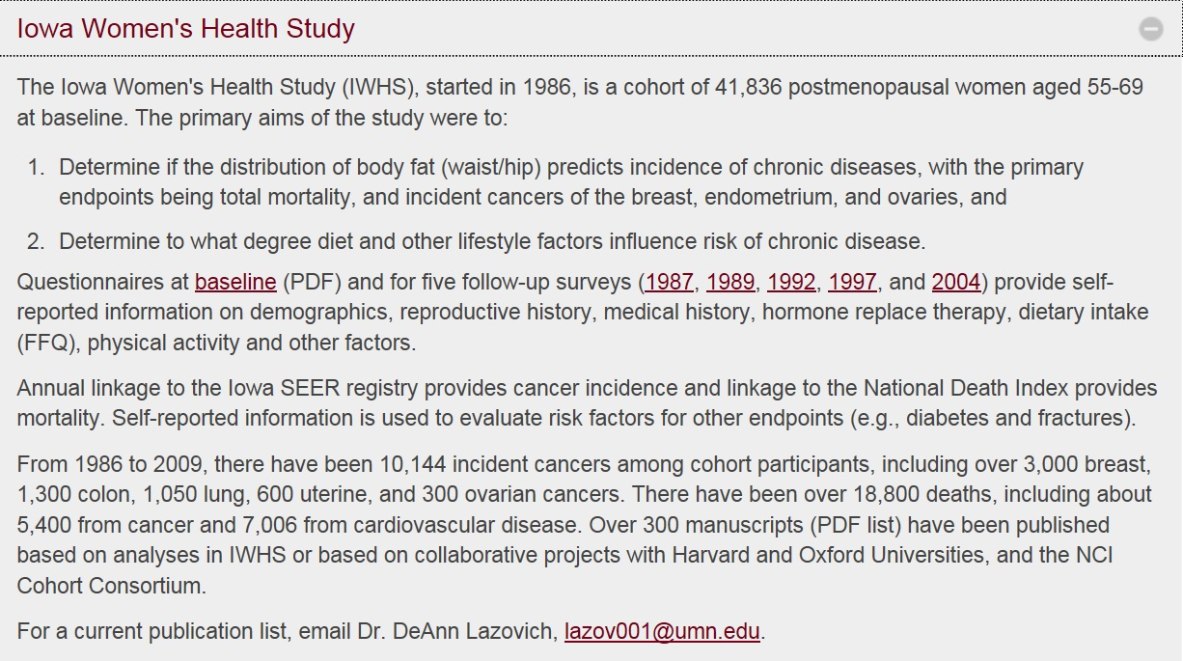
Examples:

Slide 17
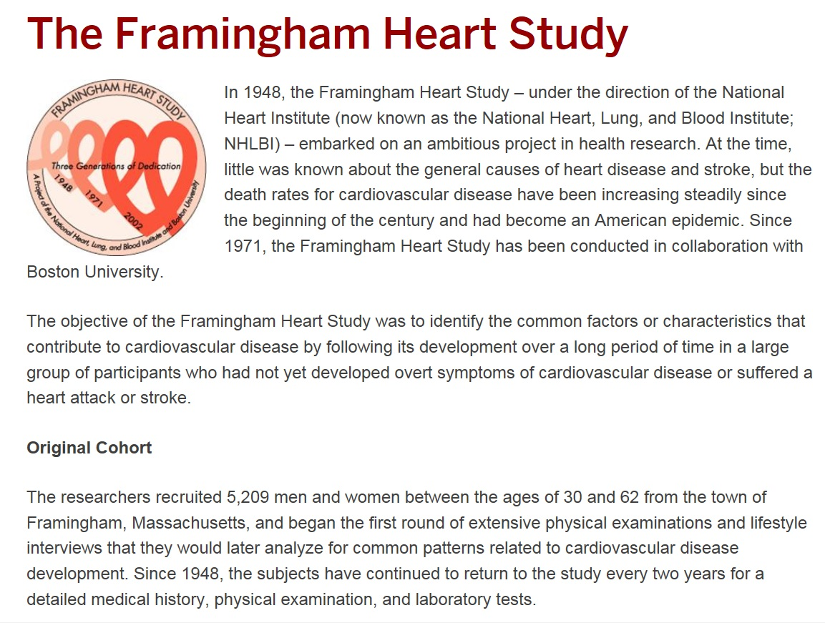
In brief, know your cohort!

Slide 18

In brief, know your cohort!

Slide 19
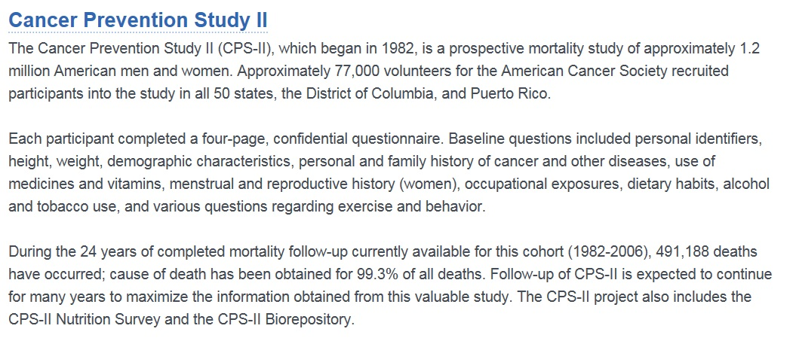
In brief, know your cohort!

Slide 20
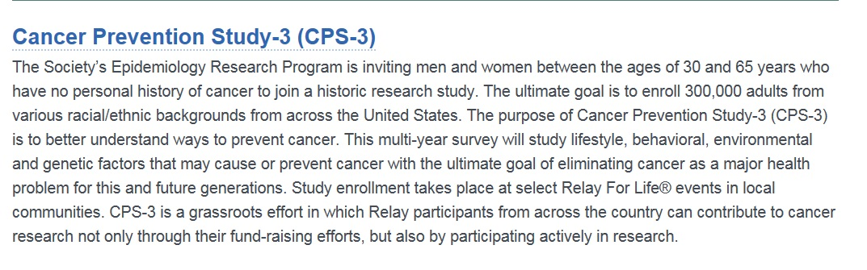
In brief, know your cohort!

Slide 21

The cohort is comprised of more than 215,000 men and women primarily of African-American, Japanese, Latino, Native Hawaiian and Caucasian origin. The ethnic diversity of Hawai‘i and California made it possible to develop this large study with its unique representation of minority populations.
Purpose The MEC Study was established to examine lifestyle risk factors, especially diet and nutrition, as well as genetic susceptibility (an inherited tendency to react more strongly to particular exposures) in relation to the causation of cancer.

Slide 22
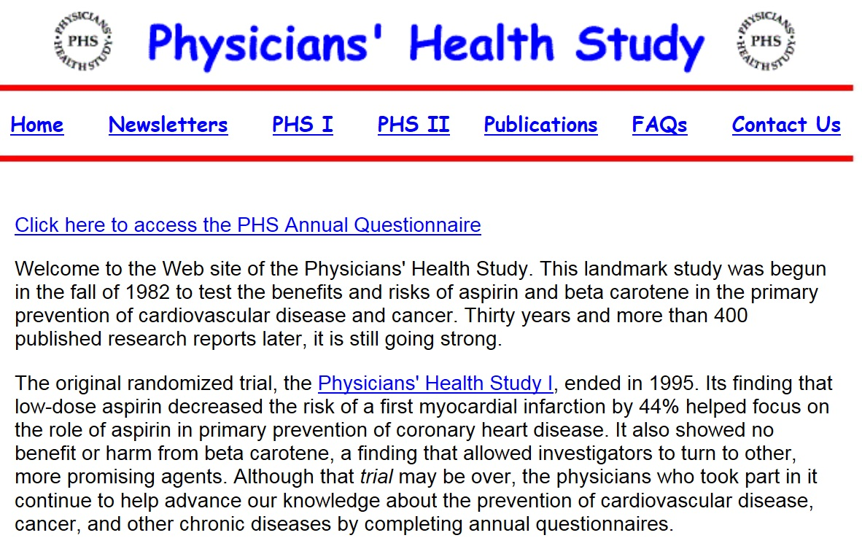

Slide 23
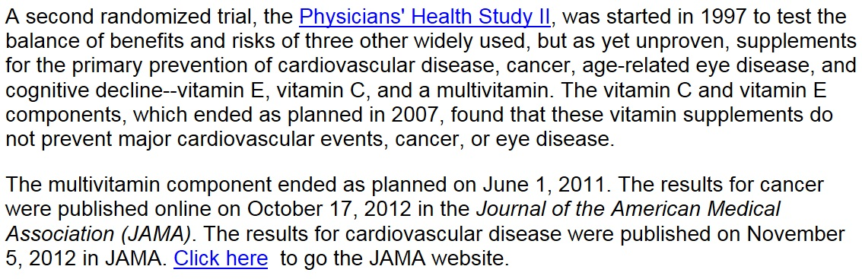
In brief, know your cohort!

Slide 24

In brief, know your cohort!

Slide 25


In brief, know your cohort!

Slide 26
The previous are all examples of studies that were specifically designed as a cohort to study a given hypothesis and actively following members.
Cohorts can also be created by using surveillance groups and passively follow for outcomes by linking with registry data that is known to have high quality data for the outcome(s) of interest.

Slide 27
Cohorts
IRB approval of hypotheses
Consent form had to allow for possibility
Should have good data for exposure(s) of interest along with outcome
When passively linking, the exposure data was collected before (i.e. BMI paper, NHIS cohort collecting information in 1987 – 1995) and then linking to a LATER outcome (heart attacks, osteoporosis, death); this is a PROSPECTIVE examination.
With EMR, lots of potential to use collected information as a cohort to answer hypotheses.

